Slide 1
Industry Trends
June 2024 – July 2024

Slide 2
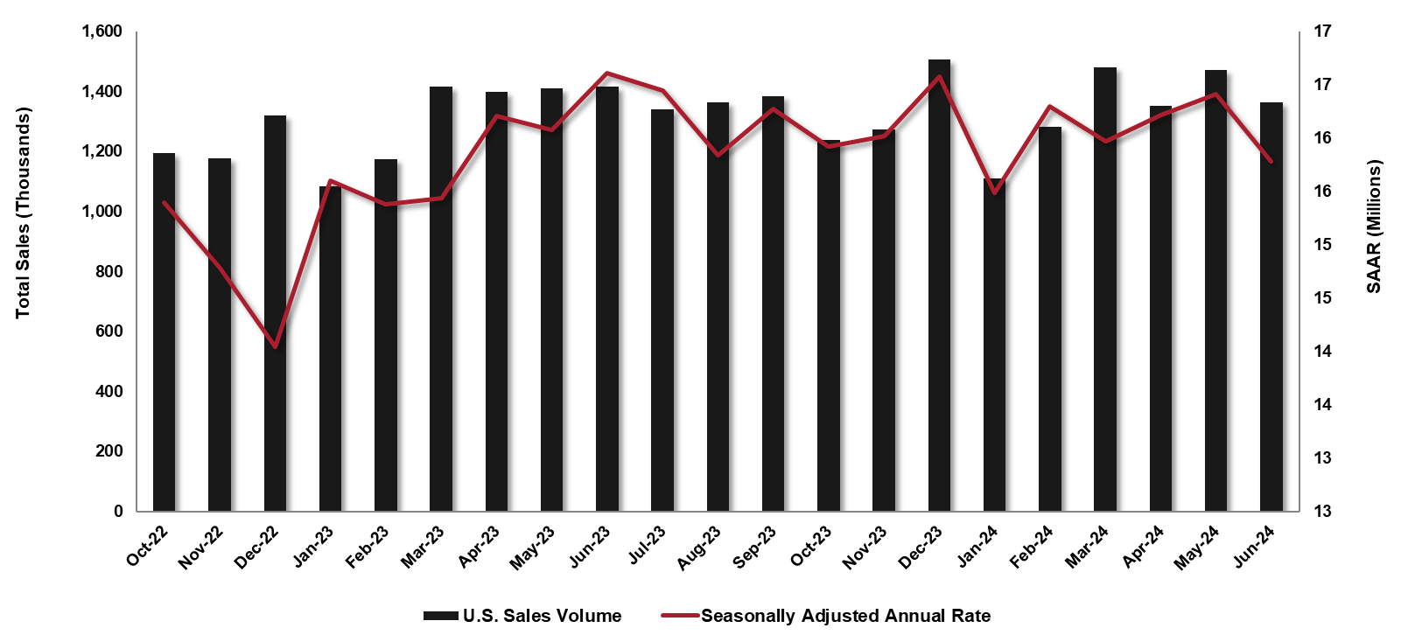
ACQUISITION
U.S. Sales Volume by Month & SAAR All Manufacturers
US Sales – All Channels
June’s sales decreased by 4% month over month.
Passenger vehicles sales decreased by 10% year over year, and light truck decreased by 1.7% year over year.
June’s light truck sales accounted for 81% of all sales.
On a seasonally adjusted annualized basis, sales fell 7.26% month over month and 3.62% year over year.
Fleet Sales
In June, 263,770 total fleet units were sold, a 3.1% year over year decrease.
Source: FRED; TD Economics; COX Automotive; JD Power

Slide 3
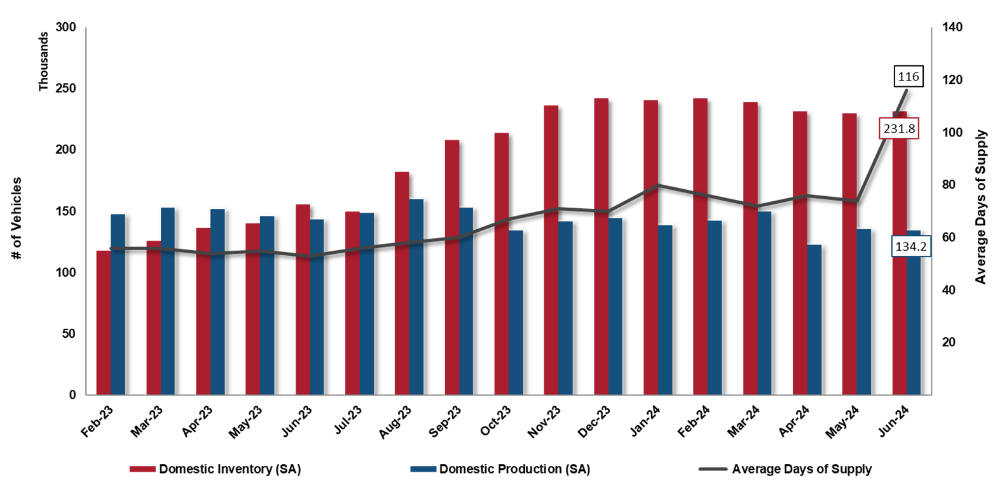
ACQUISITION
Dealer Inventory & Days of Supply
June’s new vehicle inventories ended with 231,781, a 0.7% month over month and 49.2% year over year increase.
The average dealership supply increased to 116 days compared to 74 the month prior.
New vehicle production decreased 0.9% month over month and 6.5% year over year.
June’s new vehicle price averaged $47,384, a 0.15% decrease month over month and a 0.46% year over year increase.
Recommendations:
Take advantage of opportunities for negotiation leverage as inventory increases.
Source: FRED; COX Automotive

Slide 4
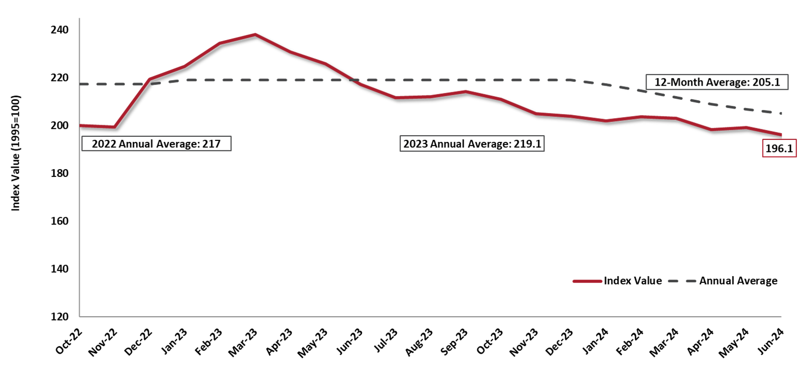
WHOLESALE RESALE MARKET
Manheim Used Vehicle Value Index
Total volume of used vehicle sales increased 1.4% year over year in June.
The Manheim Used Vehicle Value Index decreased by 9.8% year over year.
2019 (pre-pandemic) Annual Average was 138.9
All major market segments saw lower seasonally adjusted prices year over year in June.
All major segments saw overall price decreases month over month, with pickups down 1.4%
Recommendation:
While resale values have softened, prices remain well above pre-pandemic levels. Utilize Merchants’ GuaranteeBUY program to capture that increased equity.
Source: Manheim Consulting
Notes:
Done 12.15.2020

Slide 5
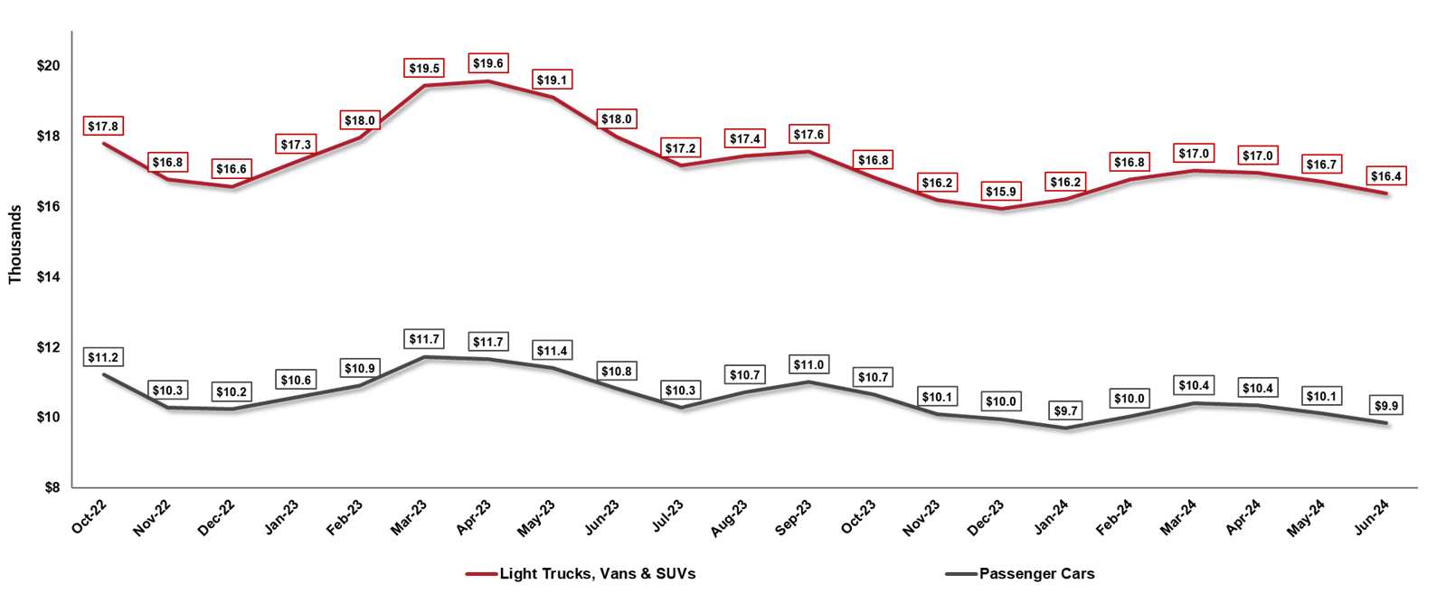
WHOLESALE RESALE MARKET
Average Wholesale Price by Segment
Wholesale prices decreased 2% month over month compared to May.
Wholesale prices saw a decrease of 7.6% year over year.
June 2024 wholesale prices are 22.8% above pre-pandemic prices.
Recommendation:
Use GuaranteeBUY for under-utilized assets when resale values tend to peak, typically between March and May.
Source: ADESA; Kontos Kommentary

Slide 6
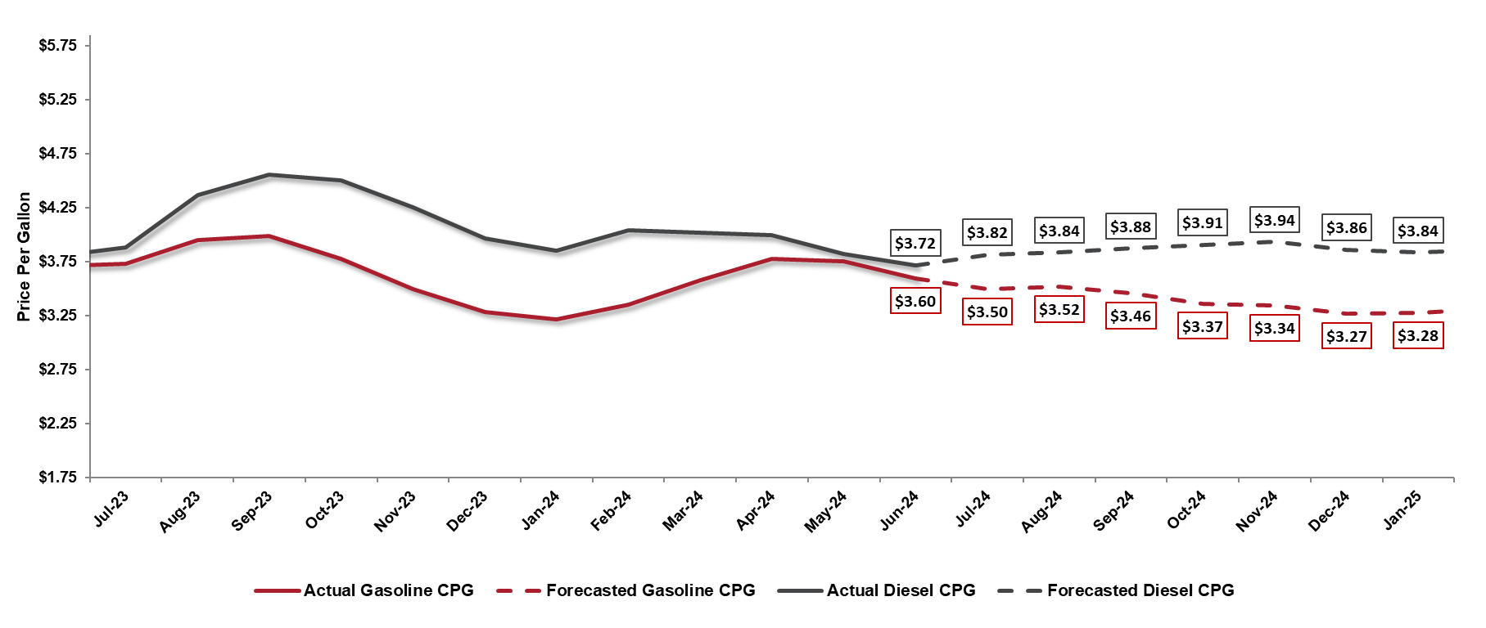
FUEL
National Average Cost per Gallon
Regular Grade & Diesel
U.S. regular gasoline prices decreased 4.1% from the previous month and averaged $3.60 per gallon in June.
U.S. diesel retail prices decreased 2.6% from the previous month and averaged $3.72 per gallon.
July’s forecasted gasoline price is $3.50 per gallon, and diesel has a forecasted price of $3.82 per gallon.
Recommendations:
Closely monitor fuel prices for accurate fuel budget forecasting.
Consider enrolling in TotalConnect to monitor driving patterns for cost savings opportunities.
Source: U.S. Energy Information Administration; FRED

Slide 7
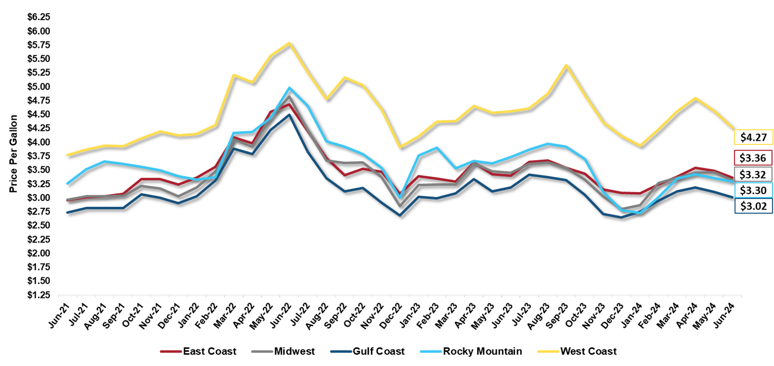
FUEL
Regional Average Cost per Gallon – Regular Grade
Overall, Regular Grade Fuel prices have decreased in June with a U.S. average of $3.44 per gallon.
Some factors that contribute to regional gas price differences:
Distance from supply
Transportation costs
State and local taxes
Retail Competition
Recommendations:
Closely monitor fuel prices and vehicle location changes for accurate fuel budget forecasting.
Consider enrolling in TotalConnect to monitor driving patterns for cost savings opportunities.
Source: U.S. Energy Information Administration; WSJ

Slide 8
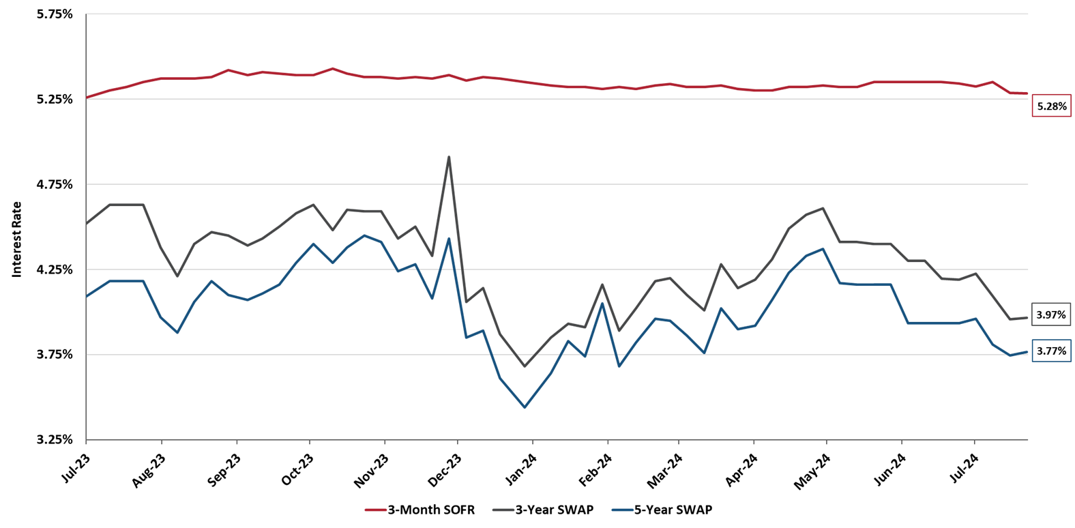
INTEREST
Interest Rates
Floating Index
Fixed Indices
3-Month SOFR rate is currently at 5.28%, a month over month decrease of 0.06%
The 3-Year SWAP rate has decreased to 3.97%
The 5-Year SWAP rate decreased and is currently 3.77%
Recommendations:
Consider using floating rates for leases going forward to take advantage of the expected decrease in future interest rates.
A fixed rate lease locks in the current, escalated interest rate for the duration of a lease.
Source: FRED; ICE Benchmark Administration Limited

