Slide 1



Industry Trends
July 2024 – August 2024

Slide 2
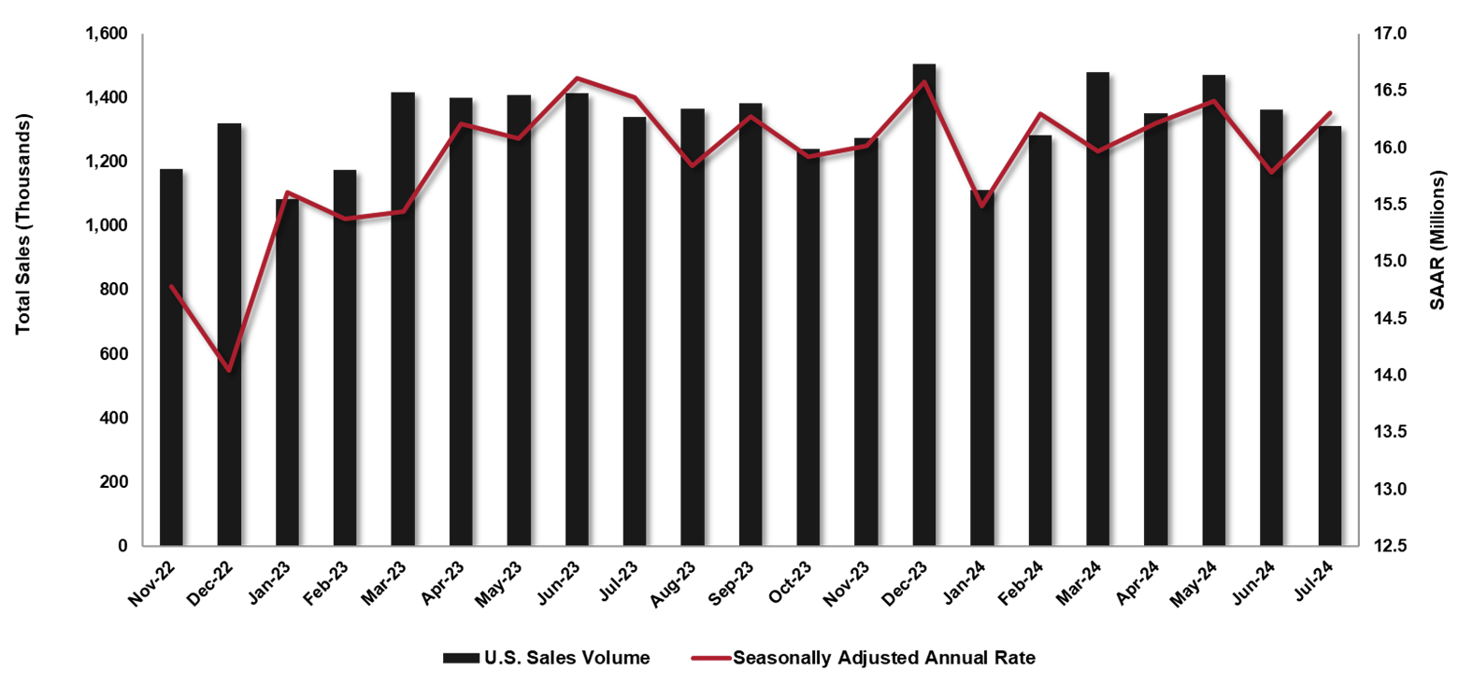

ACQUISITION
U.S. Sales Volume by Month & SAAR All Manufacturers
US Sales – All Channels
July’s sales increased by 4.2% month over month.
Passenger vehicles sales increased by 9.1% month over month, and light truck increased by 3.1% month over month.
July’s light truck sales accounted for 81% of all sales.
On a seasonally adjusted annualized basis, sales rose 3.3% month over month and fell 0.9% year over year.
Fleet Sales
In July, 147,453 total fleet units were sold, a 14% year over year decrease.
Source: FRED; TD Economics; COX Automotive; JD Power

Slide 3
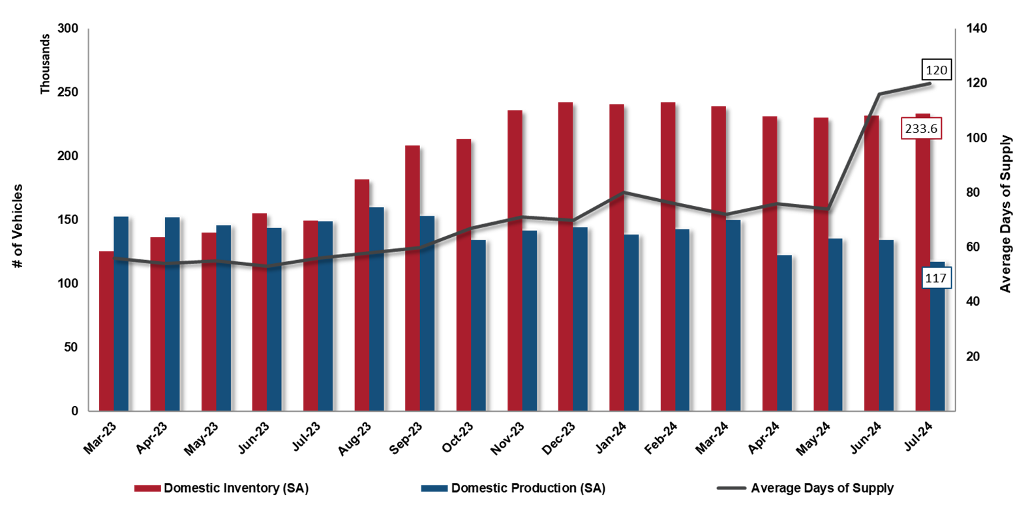

ACQUISITION
Dealer Inventory & Days of Supply
July’s new vehicle inventories ended with 233,554, a 0.8% month over month and 56% year over year increase.
The average dealership supply increased to 120 days compared to 116 the month prior.
New vehicle production decreased 12.8% month over month and 21.4% year over year.
July’s new vehicle price averaged $47,294, a 0.19% decrease month over month and a 0.28% year over year increase.
Recommendations:
Take advantage of opportunities for negotiation leverage as inventory increases.
Source: FRED; COX Automotive

Slide 4
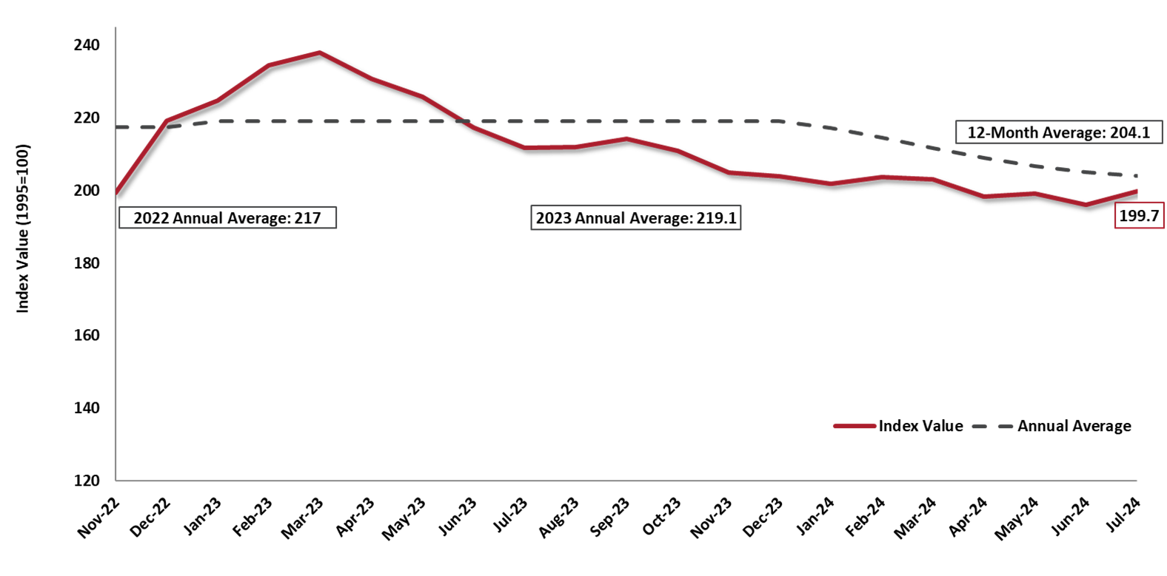
WHOLESALE RESALE MARKET
Manheim Used Vehicle Value Index
Total volume of used vehicle sales decreased 2% year over year in July.
The Manheim Used Vehicle Value Index decreased by 5.7% year over year.
2019 (pre-pandemic) Annual Average was 138.9
All major market segments saw lower seasonally adjusted prices year over year in July.
All major segments saw overall price increases month over month, with pickups up 2.6%
Recommendation:
While resale values have softened, prices remain well above pre-pandemic levels. Utilize Merchants’ GuaranteeBUY program to capture that increased equity.
Source: Manheim Consulting

Slide 5
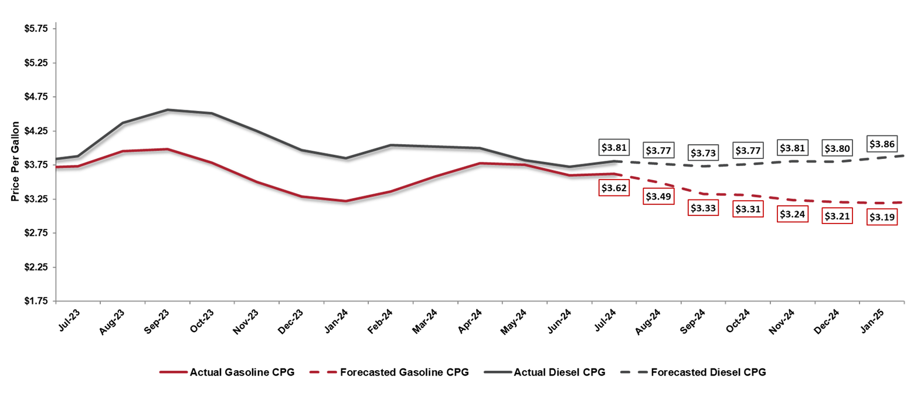
FUEL
National Average Cost per Gallon
Regular Grade & Diesel
U.S. regular gasoline prices increased 0.6% from the previous month and averaged $3.62 per gallon in July.
U.S. diesel retail prices increased 2.4% from the previous month and averaged $3.81 per gallon.
August’s forecasted gasoline price is $3.49 per gallon, and diesel has a forecasted price of $3.77 per gallon.
Recommendations:
Closely monitor fuel prices for accurate fuel budget forecasting.
Consider enrolling in TotalConnect to monitor driving patterns for cost savings opportunities.
Source: U.S. Energy Information Administration; FRED

Slide 6
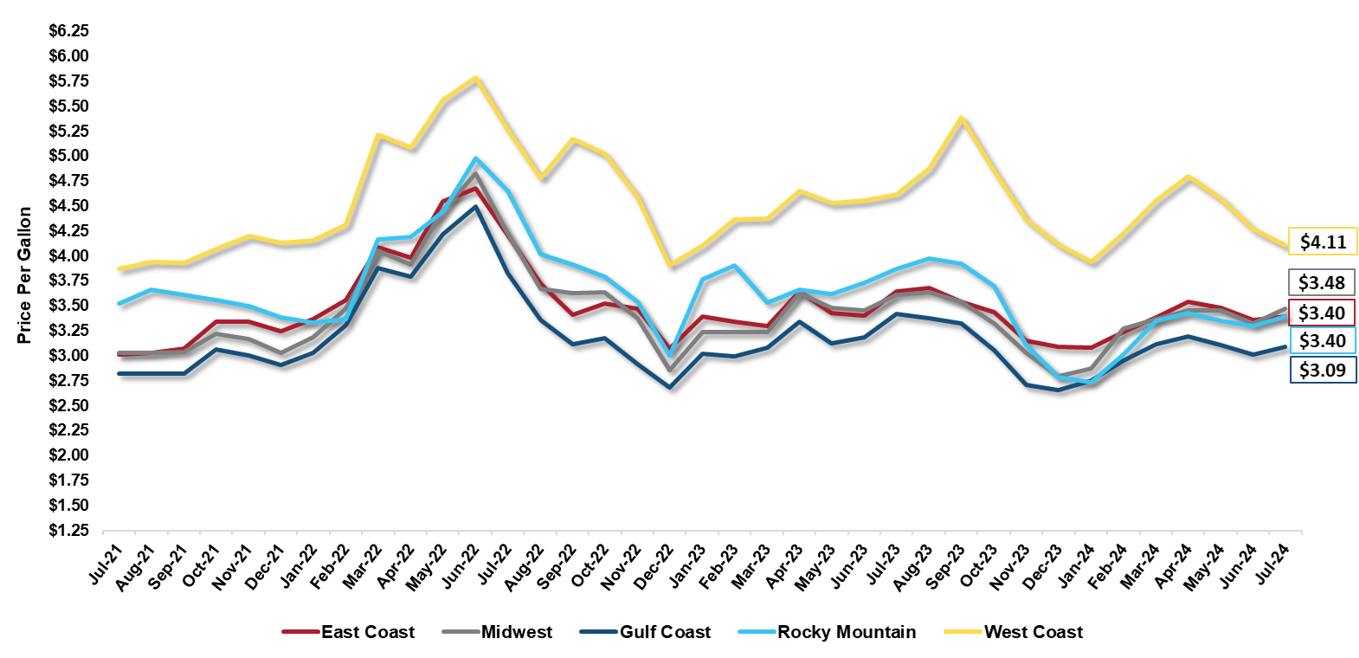
FUEL
Regional Average Cost per Gallon – Regular Grade
Overall, Regular Grade Fuel prices have increased in July with a U.S. average of $3.48 per gallon.
Some factors that contribute to regional gas price differences:
  Distance from supply
  Transportation costs
  State and local taxes
  Retail Competition
Recommendations:
Closely monitor fuel prices and vehicle location changes for accurate fuel budget forecasting.
Consider enrolling in TotalConnect to monitor driving patterns for cost savings opportunities.
Source: U.S. Energy Information Administration; WSJ

Slide 7
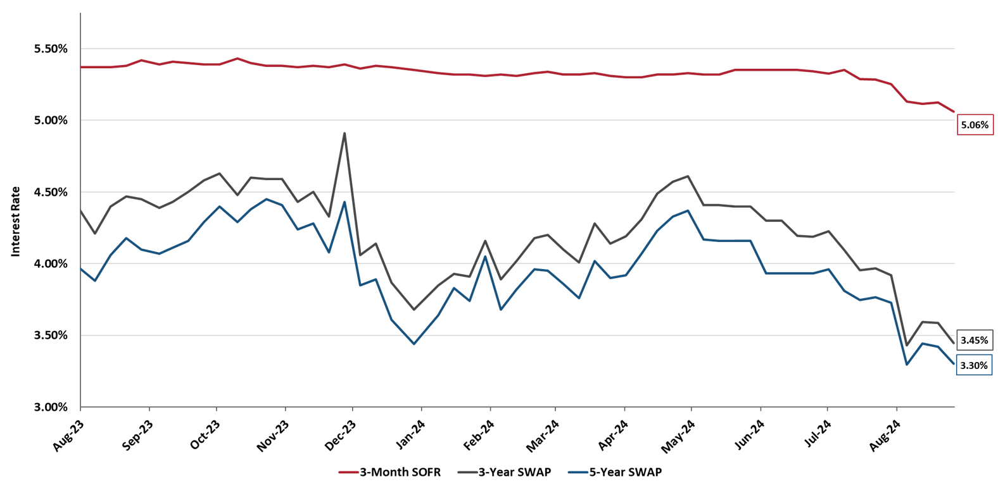
INTEREST
Interest Rates
Floating Index
Fixed Indices
3-Month SOFR rate is currently at 5.06%, a month over month decrease of 0.19%
The 3-Year SWAP rate has decreased to 3.45%
The 5-Year SWAP rate decreased and is currently 3.30%
Recommendations:
Consider using floating rates for leases going forward to take advantage of the expected decrease in future interest rates.
A fixed rate lease locks in the current, escalated interest rate for the duration of a lease.
Source: FRED; ICE Benchmark Administration Limited

